Slide 1
Ecology 8310 Population (and Community) Ecology
Application of projection matrices
Sea turtle conservation (Crouse et al.)
Notes:
Other applications exist (plentiful, e.g., Doak et al. 1994 and desert tortoises), but Crouse et al. is a classic, so no need to belabor the point; approaches are fairly similar.

Slide 2
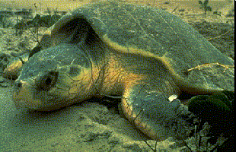
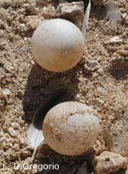
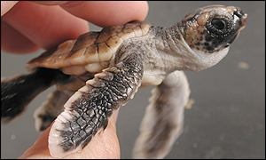
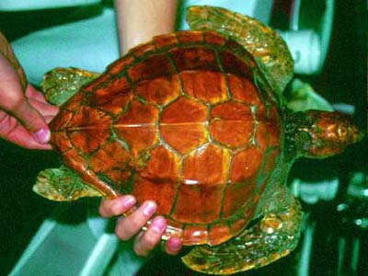
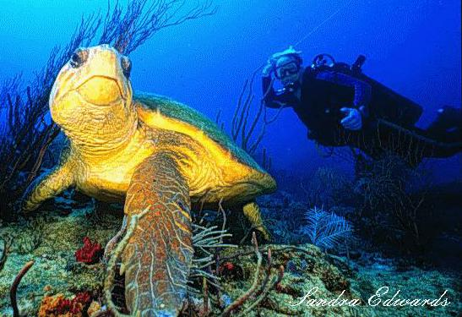
Sea Turtle Conservation:
Applying what we’ve learned

Slide 3
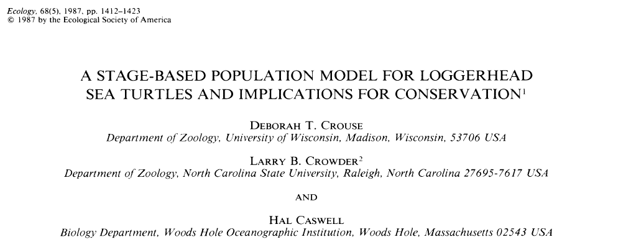

Slide 4
Stage based life table for loggerhead sea turtle
Stage | Class | Size (cm) | Age (yr) | Survival | Fecundity
1 | Eggs, hatchling | <10 | <1 | 0.68 | 0
2 | Small juv. | 10-58 | 1-7 | 0.79 | 0
3 | Large juv. | 58-80 | 8-15 | 0.68 | 0
4 | Subadult | 80-87 | 16-21 | 0.74 | 0
5 | Novice breeders | >87 | 22 | 0.81 | 127
6 | 1st-yr remigrants | >87 | 23 | 0.81 | 4
7 | Mature breeders | >87 | 24-54 | 0.81 | 80
Crouse et al.(1987) Ecology 68: 1412

Slide 5
Life cycle
diagram:
Stage | Class | Age (yr) | Survival
1 | Eggs, hatchling | <1 | 0.68
2 | Small juv. | 1-7 | 0.79
3 | Large juv. | 8-15 | 0.68
4 | Subadult | 16-21 | 0.74
5 | Novice breeders | 22 | 0.81
6 | 1st-yr remigrants | 23 | 0.81
7 | Mature breeders | 24-54 | 0.81
What does “survival represent?
Are we done?
P₁₇
P₁₆
P₁₅
1
P₂₁
2
P₃₂
3
P₄₃
4
P₅₄
5
P₆₅
6
P₇₆
7
P₂₂
P₃₃
P₄₄
P₇₇

Slide 6
Transition
Matrix:
F₇=P₁₇
F₆=P₁₆
F₅=P₁₅
1
P₂₁
2
P₃₂
3
P₄₃
4
P₅₄
5
P₆₅
6
P₇₆
7
P₂₂
P₃₃
P₄₄
P₇₇

Slide 7
Transition
Matrix:
P₁₇
P₁₆
P₁₅
1
P₂₁
2
P₃₂
3
P₄₃
4
P₅₄
5
P₆₅
6
P₇₆
7
P₂₂
P₃₃
P₄₄
P₇₇

Slide 8
Long-term behavior of system?
Notes:
i.e.how to take this information, target your actions, and get the best increase in pop growth. Management action should affect one or more elements in the matrix, but the response of lambda won't be the same. So, to inform our decision, we'd like i..,e how senstive is lambda to changes in the elements of A.

Slide 9
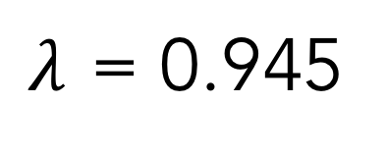
Use the projection matrix to estimate population growth rates:
$λ$ = 0.945
r = - 0.0565
Population is declining!
(matches empirical observation)

Slide 10
Stable Stage
Distribution:
Notes:
Why are there 2’s than 1’s and more 7’s than 6’s?

Slide 11
Reproductive
Value:
Life stage | Reproductive value
Eggs, hatchlings | 1
Small juveniles | 1.4
Lg. juveniles | 6
subadults | 116
Novice breeders | 567
1st yr remigrants | 507
Mature breeder | 588

Slide 12
Reproductive
Value:
By convention, scaled to 1 for newborn
Increases from birth to maturation
Thereafter, can increase or decrease (usually increase; eventually decrease)

Slide 13
But how did we get λ, RV, and SSD?

Slide 14
Methods:
Crank it out (look at long-term results)
Characteristic equation
Eigenvectors and eigenvalues
Dominant eigenvalue gives λ
Left eigenvector gives v(x) Repro. Value
Right eigenvector gives w(x), SSD
See Caswell 2001

Slide 15
What is a manager to base policy on?
Reproductive value
Sensitivity analyses
Limitation
Elasticity
Notes:
i.e.how to take this information, target your actions, and get the best increase in pop growth. Management action should affect one or more elements in the matrix, but the response of lambda won't be the same. So, to inform our decision, we'd like i..,e how senstive is lambda to changes in the elements of A.

Slide 16
Reproductive Value
Notes:
i.e.how to take this information, target your actions, and get the best increase in pop growth. Management action should affect one or more elements in the matrix, but the response of lambda won't be the same. So, to inform our decision, we'd like i..,e how senstive is lambda to changes in the elements of A.

Slide 17
Reproductive
Value:
Contribution to the future population that a female of age (stage) x will make
Depends on:
Future reproduction
Probability of surviving to realize it
Time for offspring to be produced

Slide 18
Reproductive
Value:
Life stage | Reproductive value
Eggs, hatchlings | 1
Small juveniles | 1.4
Lg. juveniles | 6
subadults | 116
Novice breeders | 567
1st yr remigrants | 507
Mature breeder | 588
Notes:
What insights can you gain from this? How can you take this info and apply it to management?

Slide 19
Sensitivity Analyses
Notes:
What is a sensitivity analysis? A change in “model output” given a change in a parameter.

Slide 20
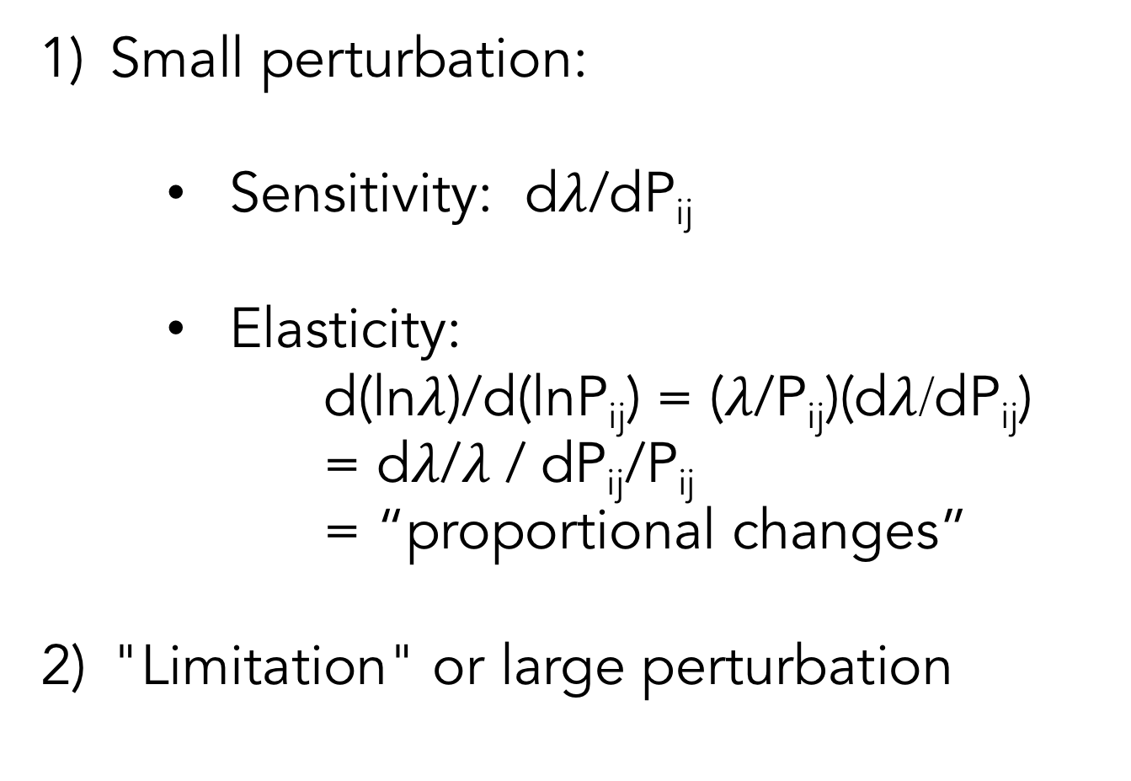
Sensitivity analyses:
Small perturbation:
Sensitivity: d$λ$/dP_{ij}
Elasticity:
d(ln$λ$)/d(lnP_{ij}) = ($λ$/P_{ij})(d$λ$/dP_{ij})
= d$λ$/$λ$ / dP_{ij}/P_{ij}
= “proportional changes”
"Limitation" or large perturbation

Slide 21
Elasticity
Notes:
i.e.how to take this information, target your actions, and get the best increase in pop growth. Management action should affect one or more elements in the matrix, but the response of lambda won't be the same. So, to inform our decision, we'd like i..,e how senstive is lambda to changes in the elements of A.

Slide 22
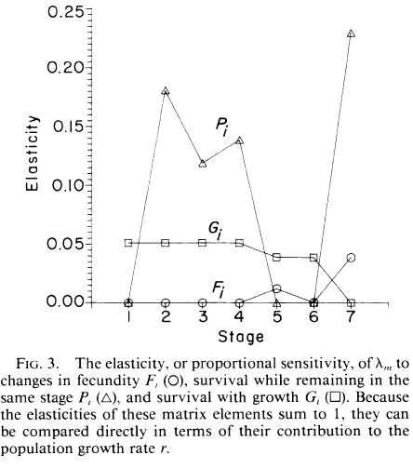
Elasticity:
Largest effects are associated with "persistence" of juvenile stages and mature breeders…
Persist, P_{ii}
Grow, P_{i+1,i}
Repro, P_{1i}

Slide 23
Limitation
Notes:
i.e.how to take this information, target your actions, and get the best increase in pop growth. Management action should affect one or more elements in the matrix, but the response of lambda won't be the same. So, to inform our decision, we'd like i..,e how senstive is lambda to changes in the elements of A.

Slide 24
Limitation:
◆ Increase survival to 100% (or increase fecundity by 50%)
How would that affect population growth rate?
Can we shift it from declining to increasing?
Which stage should we target?

Slide 25
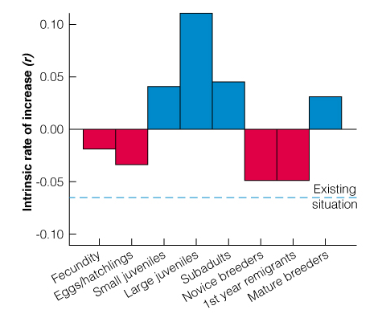
Results:
Increase survival to 100% (or increase fecundity by 50%)

Slide 26
Results:
Large Juveniles
Subadults
Eggs/hatchlings
Increase survival to 100% (or increase fecundity by 50%)

Slide 27
Surprise
Conclusion:
Focusing on eggs and hatchlings alone will NEVER
lead to recovery!

Slide 28
Target
Juveniles:
To increase λ from 0.945 to 1:
◆  Lg. juv. survival from 0.68  0.77
◆  Subadult survival from 0.74  0.88
or smaller  in both

Slide 29
Elasticity:
Why is there a greater effect for juveniles and mature breeders (vs. eggs)?
Life stage | Stage Duration
Eggs, hatchlings | <1
Small juveniles | 6
Lg. juveniles | 7
subadults | 5
Novice breeders | 1
1st yr remigrants | 1
Mature breeder | ~30
P₁₇
P₁₆
P₁₅
1
P₂₁
2
P₃₂
3
P₄₃
4
P₅₄
5
P₆₅
6
P₇₆
7
P₂₂
P₃₃
P₄₄
P₇₇

Slide 30
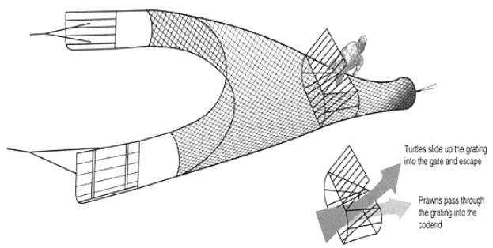
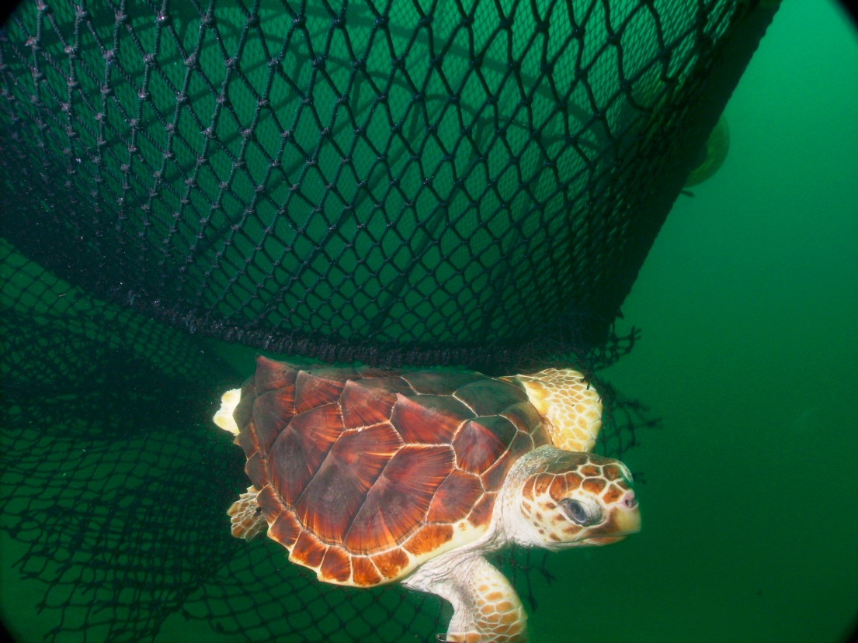
Policy Implications:
Incidental capture and drowning by shrimp trawling was the single biggest source of mortality for juveniles and subadults…
Turtle excluder device (TED):

Slide 31
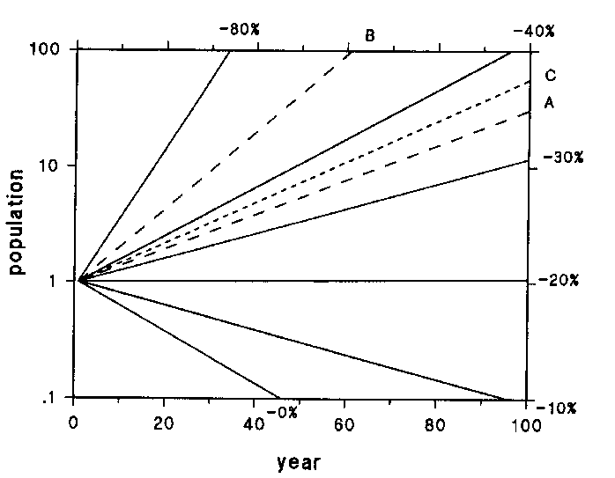
All waters,
All seasons
Seasonal offshore
Do nothing
Crowder et al. 1994. Ecol. Appl. 4:437

Slide 32
Discussion 1:
Why did RV "miss" the importance of juveniles?
In other words, articulate the essential difference between the focus of RV vs. sensitivity analyses.

Slide 33
Discussion 2:
Why did the sensitivity analyses indicate that large juveniles (and to a lesser extent small juveniles, subadults, and mature breeders) were so much more important than other stages?
i.e., what's the problem with protecting novice breeders (which have the highest fecundity!)

Slide 34
Effect of
Stage Duration:
Change annual Pr(survival) from .7 to 1.
What is effect on through stage survival?
1 year: survival increases from .7 to 1.0
2 years: survival increases from .49 to 1.0
10 years: survival increases from 0.03 to 1.0

Slide 35
Discussion 3:
Do these measures of response (even if the underlying math and biology are accurate) tell us what we need to know to set policy?
Notes:
Enforcement?
Feasibility?
Economics? might be better to know d(lambda)/d$

Slide 36
Discussion 4:
Why might recovery be slower (or different) than projected
(as it was)?
Notes:
Transient dynamics
Cheaters (noncompliance)
Parameter estimates incorrect
Environment changed (so parameters no longer apply): e.g., oil spill
Density Dependence

Slide 37
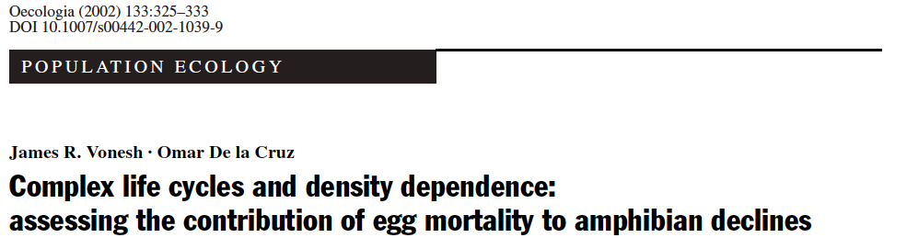


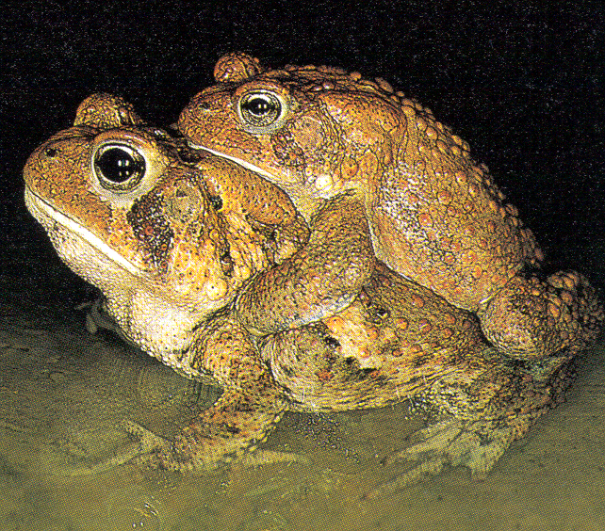
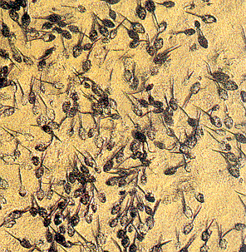
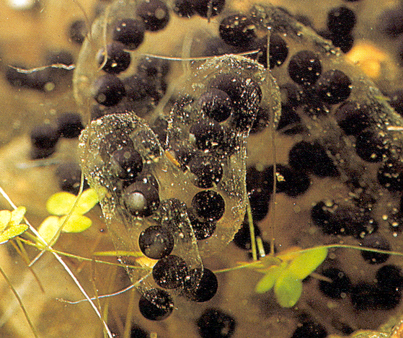
James R. Vonesh
Dept. of Zoology
University of Florida
(Professor at VCU)
Omar De la Cruz
Dept. of Mathematics
Purdue University
(Asst. Prof at Kent State)

Slide 38
Application: Amphibian Declines

Slide 39
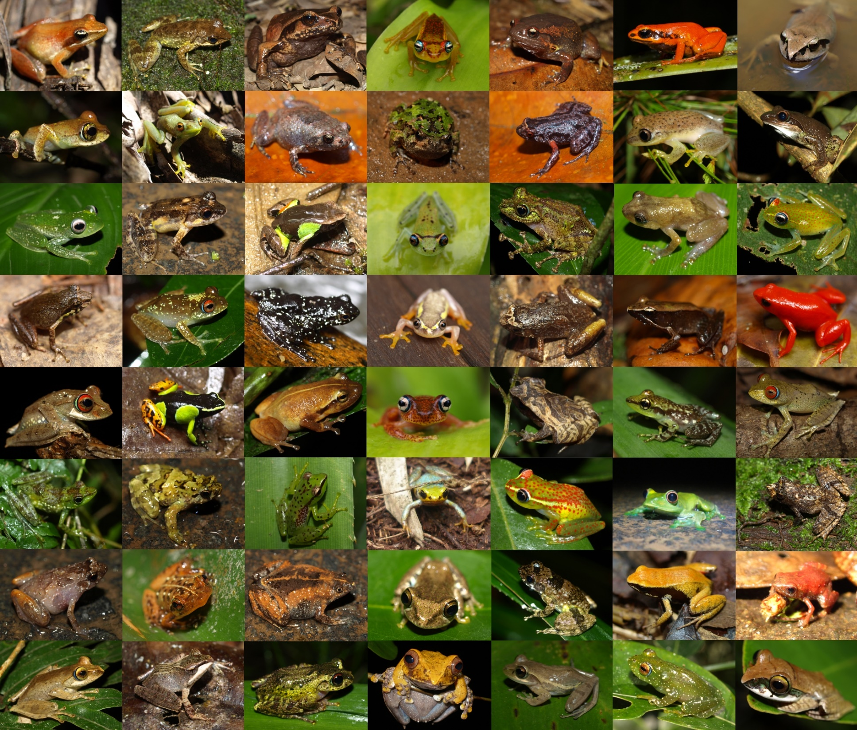
7000 known species of
amphibians
Existed for > 300 million years
Last 30 years, massive declines:
168 species extinct
2,469 declining

Slide 40
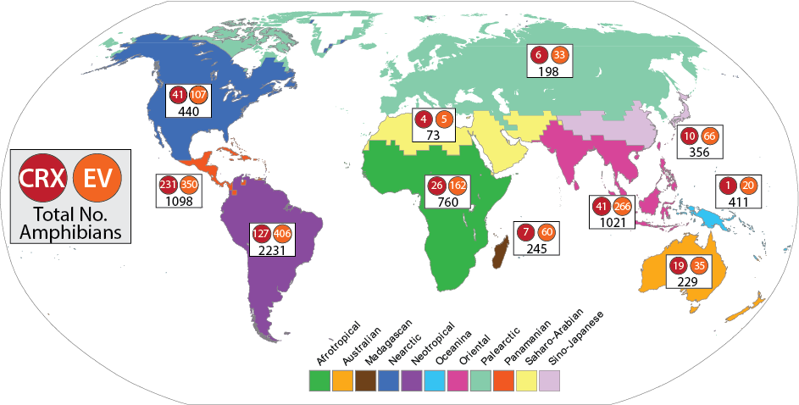
Red = extinct, critically endangered; Orange = threatened; Black = total no. per biome
Notes:
Notice that >half of central American amphibians are extinct, critically endangered or threatened!

Slide 41
Many causes ...

Slide 42
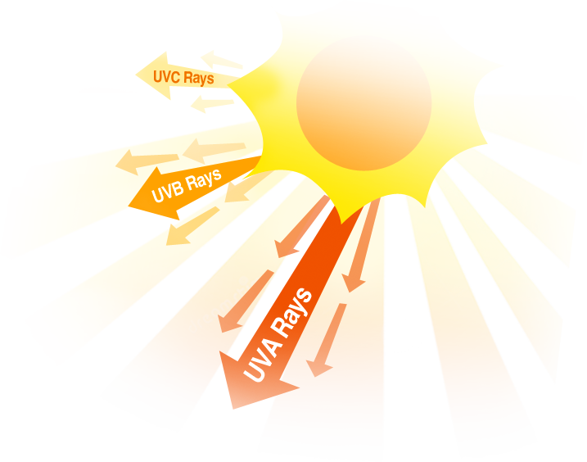
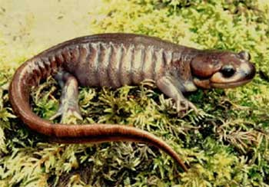
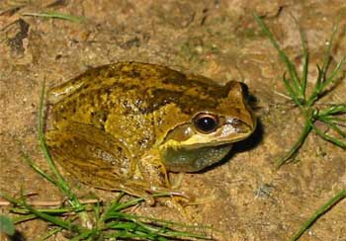
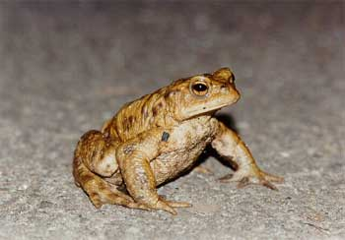
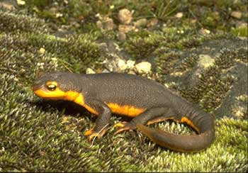
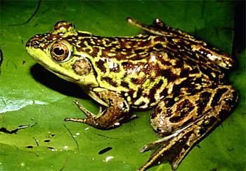
UV-B Radiation
Absorbed by
ozone layer
Harmful to living
organisms
Not absorbed
by most biomolecules
Research focused on sensitive of eggs to UVB
Notes:
Lots of attention in the 70’s 80’s and 90’s because of chemicals like chloroflourocarbons that degraded the ozone later (ozone prevents UVB from penetrating to earth’s surface). Montreal Protocol banned CFC’s and other ozone-degrading substances in 1987. Slow recovery ever since…

Slide 43
Context:
Amphibian populations in decline
Focus on increased egg mortality (e.g., due to UV-B radiation)
Goal:
to assess if increased egg mortality can explain declines, and if not, what life stage should be the focus (i.e., inform future empirical studies)
Approach:
Stage-structured model, with density-dependent tadpole survival
Parameterize model with data from amphibians
Effect of elevated egg mortality (vs. mortality at other stages)
Key result:
density-dependence buffers effect of egg mortality on adult density
Effects on later life stages are more important

Slide 44
Primary Objective of the Study
What are the population-level consequences of UV-B induced egg mortality?
For example, if egg survival is reduced from 100% to 20%, what will be the change in adult population size?

Slide 45
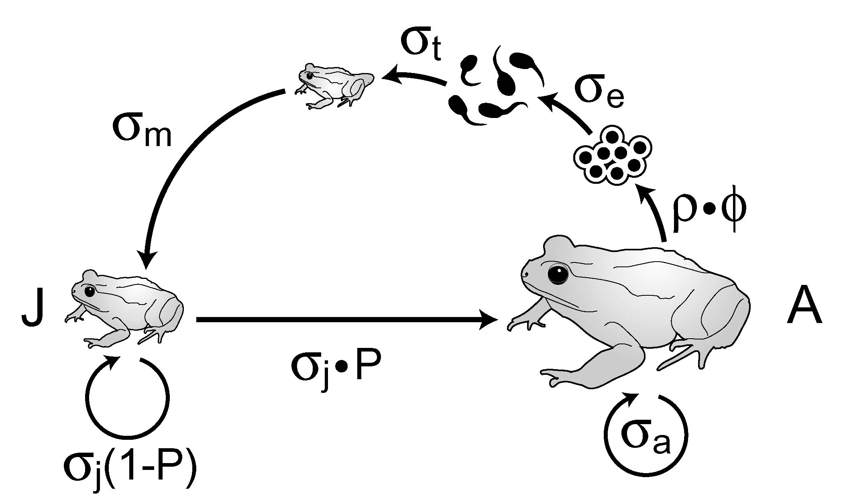
Generalized Anuran (Frogs and Toads) Life Cycle
Primary effect of environment
State variables
A – adult density
J – juvenile density
Reproduction parameters
ρ - sex ratio (prop. female) = 0.50
– clutch size
Transition probabilities
σ_{e} – egg survival
σ_{t} – tadpole survival
σ_{m} – metamorph survival
σ_{J} – juvenile survival
σ_{a} – adult survival
P – juvenile maturation to adults
Target of concern

Slide 46
Problem 1:
Given the generalized life cycle used in this paper, assume that you observe an adult frog at “Year 1” (which was immature the year before)...
will it be alive 1 year later?
will there be eggs present one year later that were spawned from that adult?
will there will be tadpoles present one year later that were spawned from that frog?
will there be metamorphs present one year later that were spawned from that frog?
will be juveniles present in Year 2 that were spawned from that frog?

Slide 47
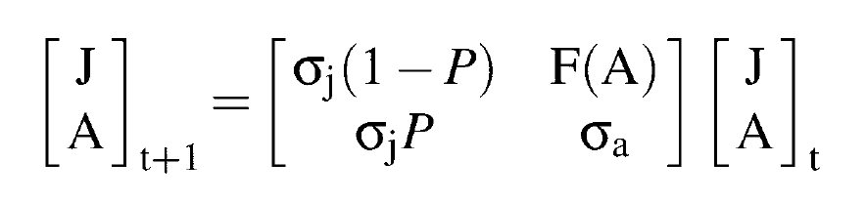
F(A)

Slide 48
Problem 2:
Based on the life cycle diagram:
Write out an equation that describes the number of Juveniles at time t+1 as a function of the number of Juveniles at time t and the number of Adults at time t.
Write out an equation that describes the number of Adults at time t+1 as a function of the number of Juveniles at time t and the number of Adults at time t.

Slide 49
F(A)
Where do next year’s juveniles come from?
$$J_{t+1}=A_{t}F\left(A_{t}\right)+J_{t}σ_{j}\left(1−P\right)=A_{t}ρϕσ_{e}σ_{t}σ_{m}+J_{t}σ_{j}\left(1−P\right)$$

Slide 50
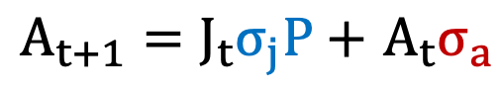
What about the adults?
$A_{t+1}=J_{t}σ_{j}P+$ $A_{t}σ_{a}$

Slide 51
Let’s put it all together… (in various ways)

Slide 52
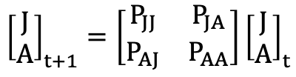
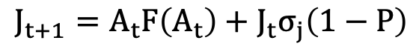
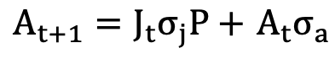
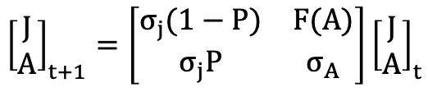
F(A)
$$J_{t+1}=A_{t}F\left(A_{t}\right)+J_{t}σ_{j}\left(1−P\right)$$
$A_{t+1}=J_{t}σ_{j}P+$ $A_{t}σ_{a}$
P_{JA} = F(A)
$${\left[\begin{matrix}J \\ A\end{matrix}\right]}_{t+1}=\left[\begin{matrix}P_{JJ} & P_{JA} \\ P_{AJ} & P_{AA}\end{matrix}\right]{\left[\begin{aligned}J \\ A\end{aligned}\right]}_{t}$$
P_{AJ} = σ_{j}P
J
A
$${\left[\begin{matrix}J \\ A\end{matrix}\right]}_{t+1}=\left[\begin{matrix}σ_{j}(1−P) & F(A) \\ σ_{j}P & σ_{A}\end{matrix}\right]{\left[\begin{aligned}J \\ A\end{aligned}\right]}_{t}$$
P_{JJ} = σ_{j}(1-P)
P_{AA} = σ_{a}

Slide 53
What’s next…

Slide 54
Tadpole survival is usually density dependent

Slide 55
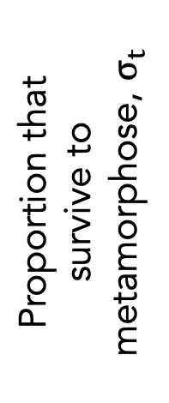
Problem 3:
Draw the relationship between “The proportion of tadpoles that survive to metamorphose” (on the y-axis) versus “The initial number of tadpoles” (on the x-axis)
1
Proportion that survive to metamorphose, $σ_{t}$
0
0
Initial tadpole density (T)

Slide 56
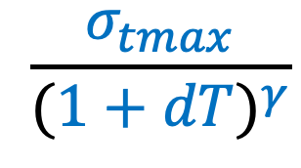
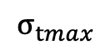
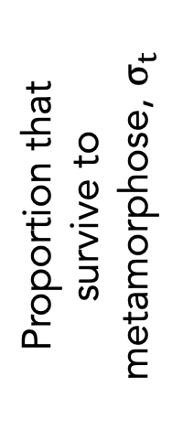
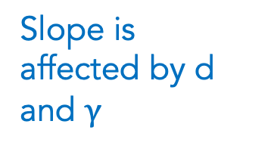
1
$$σ_{tmax}$$
$$\frac{σ_{tmax}}{{(1+dT)}^{γ}}$$
Proportion that survive to metamorphose, $σ_{t}$
Slope is affected by d and $γ$
0
0
Initial tadpole density (T)
Notes:
Both d and gamma tell us about the effect of density dependence. It’s a bit complicated. And it’s really had to see the effects on this plot, so now, let’s ask not about the proportion of tadpoles that make it to metamorphosis, but about the NUMBER that make it….

Slide 57
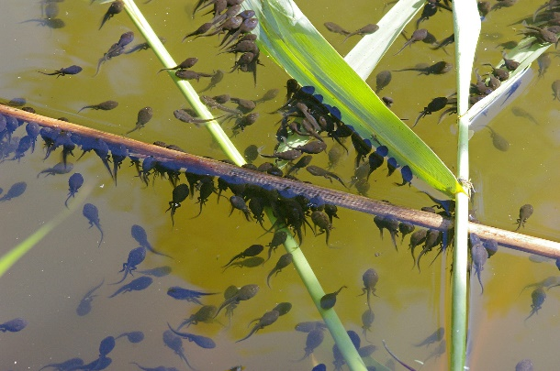
Bufo americanus (Wilbur 1977)

Slide 58
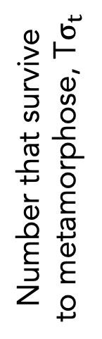
Problem 4:
Draw the relationship between “The number of tadpoles that survive to metamorphose” (on the y-axis) versus “The initial number of tadpoles” (on the x-axis)
Number that survive to metamorphose, T$σ_{t}$
0
0
Initial tadpole density (T)

Slide 59
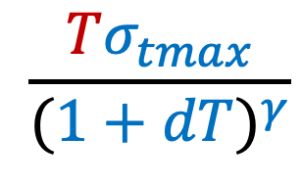
T
$$\frac{Tσ_{tmax}}{{(1+dT)}^{γ}}$$
survival
Initial tadpole density (T)
Notes:
These two curves represent the two parts of the function we’re interested in. We need to product of these two curves. The answer will depend on the relative rate at which the blue curve decreases (and that’s controlled by gamma)….

Slide 60
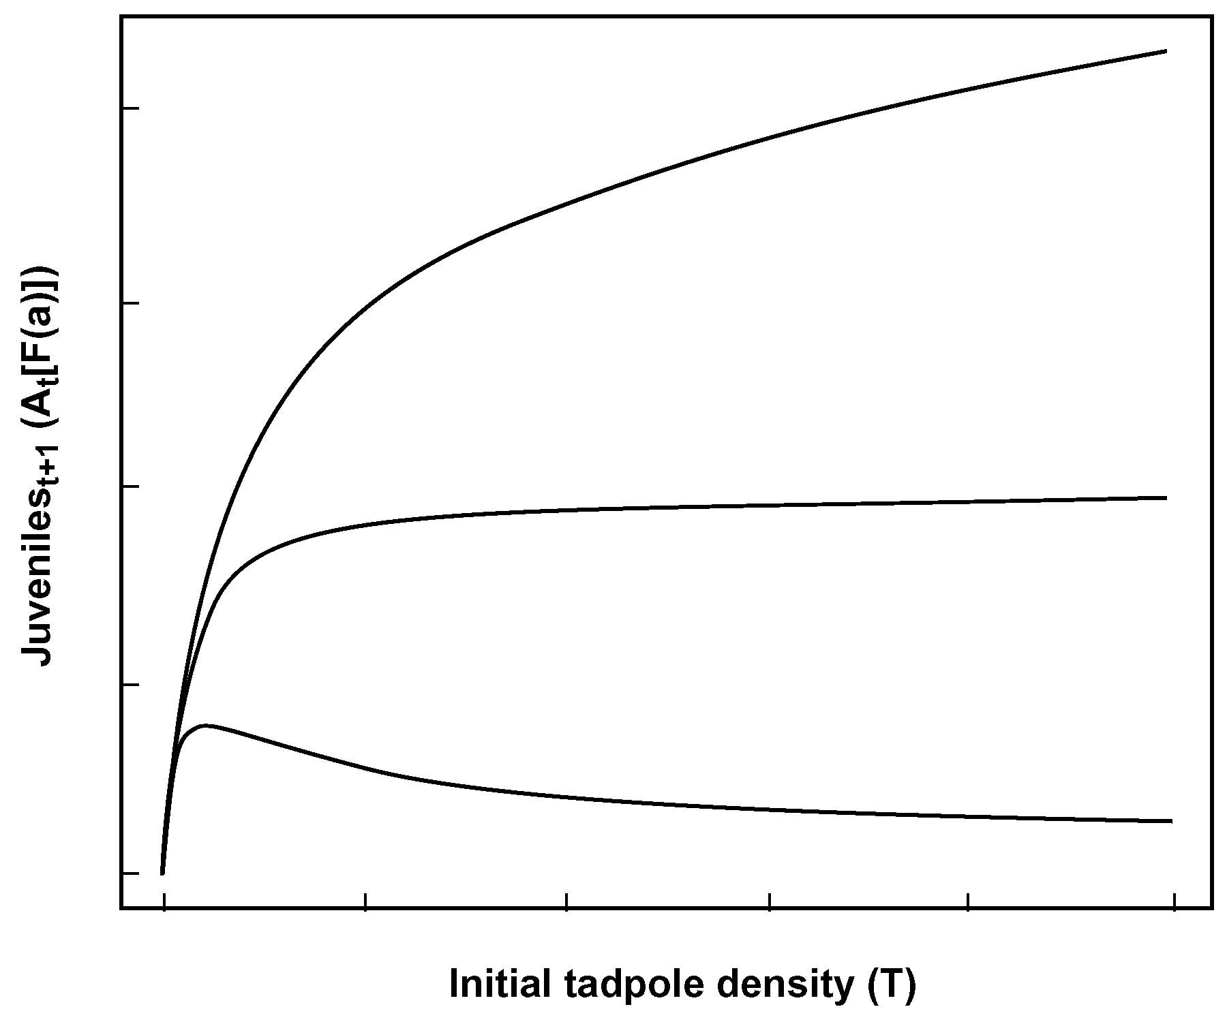
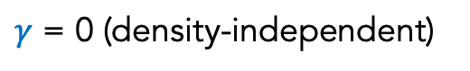
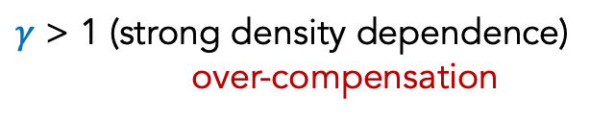
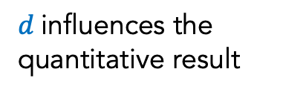
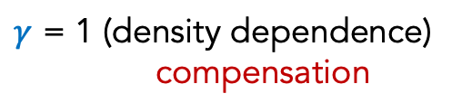
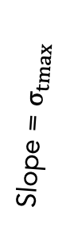
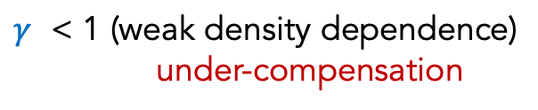
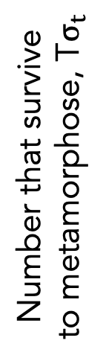
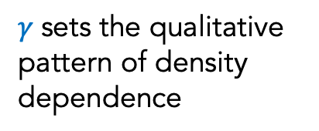
$γ$sets the qualitative pattern of density dependence
$γ$ = 0 (density-independent)
$γ$ < 1 (weak density dependence)
under-compensation
Slope = $σ_{tmax}$
$γ$ = 1 (density dependence)
compensation
Number that survive to metamorphose, T$σ_{t}$
1/d
$γ$ > 1 (strong density dependence)
over-compensation
0
0
Initial tadpole density (T)
Adults_{t} (A_{t})
$d$influences the quantitative result

Slide 61

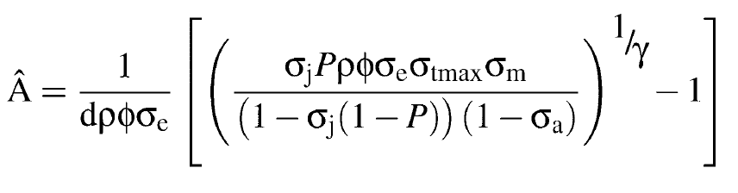

Objective of the study:
What are the population level consequences of mortality at different stages, particularly the egg stage, due to UV – B radiation?
Approach:
Solve equilibrium (A_{t+1}=A_{t}; J_{t+1}=J_{t}): $\hat{A}, \hat{J}$
Analyze stability
Quantify the effect of UV-B on $\hat{A}$
Limitation
Elasticity

Slide 62
Problem 5:
What is elasticity? Describe it in words.

Slide 63

Problem 5:
What is elasticity? Describe it in words.
The change in an output of a model (e.g., $\hat{A}$) caused by a change in a parameter (e.g., $σ_{e}$), expressed as proportions.
OR
The proportionate change in $\hat{A}$caused by a small proportionate change in $σ_{e}$
OR
Symbolically: $\frac{{d\hat{A}}/{\hat{A}}}{{dσ_{e}}/{σ_{e}}}$ = d(ln$\hat{A}$)/d(ln$σ_{e}$)
Notes:
“sensitivity” is usually defined as a change in output caused by a small change in a parameter. Elasticity alters that definition by looking at proportionate changes (rather than absolute changes).

Slide 64



Elasticity: egg survival
Elasticity = 0: no effect
Elasticity <1: effect “dampened”
Elasticity=1; effect is equal
Elasticity >1: effect “amplified”
Elasticity<0: effect “reversed”
Background survival
Let’ focus on $γ=1$
$$γ=.75?$$
$$γ=1.25?$$
Elasticity = 0
$$γ$$

Slide 65



γ = 0.8
γ = 0.9
($\hat{A}$)
γ = 1.0
γ = 1.1
Effect of decreased
egg survival on adult
densities will depend upon the
strength of density
dependence ($γ$) as well as the background survival
γ = 1.2
no UV-b
Elasticity is related to the slope
(σ_{e} )
Notes:
I have figures that didn’t appear in the paper, that might help you understand some issues a bit better. This is a helpful one that shows that when gamma=1, there is no change in A* with a change in egg survival (unless egg survival is already very low).

Slide 66
Conclusion of the study:
Density dependent tadpole survival buffers amphibian populations from environmental stressors that decrease egg mortality
But, variation in life history among different species (e.g. low vs. high fecundity) influences the effects of density dependence
What about other life stages?
How much does a change in other parameters affect adult densities?

Slide 67

Notes:
Notice that there is a much bigger effect (darker colors) if the mortality affects LATER stages, especially juveniles and adults, rather than eggs.

Slide 68




γ = 0.8
γ = 0.9
γ = 1.0
adult population (A*)
γ = 1.1
adult population
γ = 1.2
natural range
for B. bufo
clutch size (φ)
max. tadpole survival (σ_{t max} )
↓ values for parameters of other stages = ↓ in adult densities
The effects on later stages are more important than eggs
adult population (A*)
juvenile survival (σ_{j} )
adult survival (σ_{A} )
Notes:
Here, is an easier way to visualize these effects. Notice how steep the curves are for the plot in the lower right (i.e., changing adult survival has a huge effect on A*: elasticity >1). Effects of changing max tadpole survival or juvenile survival are less extreme (elasticity close to 1)

Slide 69
Bottom-lines:
Density-dependence at subsequent stages affects population response to mortality.
Species differences in life history can lead to variable response (not just “sensitivity” to mortality agent).
Need to evaluate other factors at other stages (e.g., chytrid and adult).
Caution: multiple stressors.

Slide 70


Slide 72


Slide 73


$γ$= 1
Warmer colors indicate
higher adult population
densities
When mean clutch size is low:
At low density dependence
(d close to 0), ↓ in egg
survival = large ↓ adult
densities
At high density dependence
(d close to 100), ↓ in egg
survival = small ↓ adult
densities
with UV-b
no UV-b
(A*)
d
(σ_{e} )

Slide 74



clutch size = 10
clutch size = 50
$γ$ = 1
When mean clutch size is high:
Even when density
dependence is weak, ↓ in egg survival result in
little change in A*
Why?
stable adult population size (A*)
clutch size = 100
clutch size = 200
d
egg survival (σ_{e})

Slide 75



Slide 76


Slide 77


Slide 78


